Slide 1
PANIMALAR ENGINEERING COLLEGE
BATCH NO: D-14
MINI PROJECT
PERSONALITY PREDICTION ANALYSIS
USING MACHINE LEARNING
DONE BY, GUIDE BY,
Mrs. M ABIRAMI
NAME: SWATHY SREE C S
REG NO: 211422104509
NAME: SRUTHI K
REG NO: 211422104484

Slide 2
ABSTRACT
This project aims to predict Myers-Briggs Type Indicator (MBTI) personality types from textual data using machine learning techniques. The process includes cleaning and preprocessing text data, followed by feature extraction using Term Frequency-Inverse Document Frequency (TF-IDF). Various models, such as Naive Bayes, Random Forest, Support Vector Machines (SVM), Light GBM, and XG Boost, are trained and evaluated. XGBoost achieved the highest accuracy at 67.55%, outperforming other models. The study demonstrates the effectiveness of ensemble learning for personality classification and suggests future exploration of deep learning models to enhance performance further.

Slide 3
INTRODUCTION
Personality prediction has garnered significant attention in both psychology and machine learning communities due to its potential applications in marketing, recruitment, social media analysis, and human-computer interaction. The Myers-Briggs Type Indicator (MBTI), one of the most widely recognized personality classification systems, categorizes individuals into 16 distinct personality types based on four dichotomies: Introversion (I) vs. Extraversion (E), Intuition (N) vs. Sensing (S), Thinking (T) vs. Feeling (F), and Judging (J) vs. Perceiving (P). With the growing amount of user-generated content on social media, there is an increasing opportunity to leverage machine learning models for automatically classifying individuals into personality types based on their textual data.
This project aims to explore the use of natural language processing (NLP) and machine learning techniques to predict MBTI personality types from textual posts. We utilize the MBTI dataset, which consists of posts collected from various social media platforms, each label with a specific MBTI personality type. The task presents several challenges, including the high dimensionality of text data and the complexity of predicting 16 distinct personality types from relatively short text samples.

Slide 4
PROBLEM STATEMENT
The problem statement of this project is to develop an efficient model for predicting Myers-Briggs Type Indicator (MBTI) personality types based on textual data from user posts. Personality prediction can be valuable in various applications like personalized recommendations, team building, and mental health analysis. The challenge lies in processing and extracting meaningful features from unstructured text data, followed by training machine learning models that can accurately predict one of the 16 MBTI personality types. This multi-class classification task demands effective feature extraction, appropriate model selection, and handling of imbalanced data for reliable personality type prediction.

Slide 5
EXISTING SYSTEM
Existing personality prediction systems primarily use machine learning algorithms such as Naive Bayes, Random Forest, and SVM, relying on features like Bag of Words (Bo W) or Term Frequency-Inverse Document Frequency (TF-IDF) from text data. While these approaches have shown moderate success, they often struggle with handling complex, context-dependent information in the text.
More advanced deep learning models, like RNNs and BERT, offer better performance by capturing deeper contextual relationships but require large datasets and computational resources. Existing systems also face challenges like class imbalance and overfitting due to high-dimensional textual data.

Slide 6
PROPOSED SYSTEM
Text Preprocessing: The system processes raw text data by removing noise such as URLs, special characters, numbers, and stop words. It also applies techniques like tokenization, lemmatization, and normalization to prepare the data for machine learning models.
Feature Extraction: The Term Frequency-Inverse Document Frequency (TF-IDF) method is used to convert the text into numerical representations that reflect the importance of terms in the dataset, enabling the models to handle textual input effectively.
Machine Learning Models: The system implements various machine learning algorithms, including Naive Bayes, Random Forest, Support Vector Machines (SVM), XG Boost, Light GBM, and Logistic Regression, to predict personality types. These models are evaluated to identify the best-performing one.
Model Evaluation: Performance metrics such as accuracy and classification reports are used to compare the models. Based on the results, ensemble learning models like XG Boost and Light GBM are expected to provide higher accuracy due to their ability to handle complex data.

Slide 7
LITERATURE SURVEY
1."Smart-Hire Personality Prediction Using ML" (May 2023) by Isha Gupta and Manasvi Jain:
This study underscores the practical implications of personality classification types through ML predictions, can actively engage in self-improvement efforts. It suggests that individuals, upon discovering their personality.
2."A Study on Personality Prediction & Classification Using Data Mining Algorithms" (August 2022) by Pavitha N., Somesh Kamnapure, and Ayush Gundawa:
Highlighting the importance of personality in personal and professional contexts, this work explores data mining algorithms to rapidly predict and categorize an individual's personality.
3."Language Style Matters: Personality Prediction from Textual Styles Learning" (November 2023) by Meiling Li and Hezi Liu:
This research delves into psycholinguistic literature, emphasizing the role of language styles in unveiling personality aspects. The paper contends that language styles offer insights into users' personalities, including social networks and mental health. Textual styles learning is presented as a valuable approach for personality prediction.
4."Personality Prediction using Machine Learning" (June 2022) by Hima Vijay and Neenu Sebastian:
Acknowledging the importance of sorting individuals based on personality types, this work emphasizes the applications of ML algorithms in achieving this goal.

Slide 8
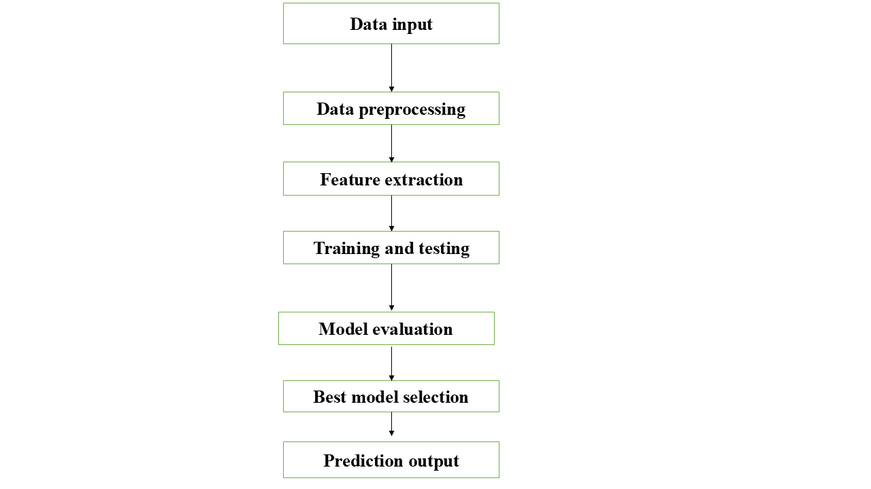
FLOW CHART
Fig 1. Flow chart for the analysis process

Slide 9
METHODOLOGY
The methodology for this project begins with data collection and preprocessing. User posts are cleaned through text normalization, removing noise like URLs and numbers, and lemmatization. Preprocessing is crucial to clean the text data, which includes converting text to lowercase, removing URLs, numbers, and unwanted symbols, and applying lemmatization to reduce words to their base form. Stopwords are also removed to focus on meaningful words.Stopwords are removed, and the Term Frequency-Inverse Document Frequency (TF-IDF) method is used to convert the text into numerical form. The dataset is split into training and testing sets, ensuring proper distribution of personality types. Various machine learning models, including Naive Bayes, Random Forest, XGBoost, and SVM, are trained and evaluated. The models' performance is measured using accuracy and classification reports to determine the best classifier.

Slide 10
MODULE
Model training module
Gaussian Naive Bayes (GNB)
Simple and fast; however, GNB's assumption of feature independence limits its performance in complex datasets like personality prediction.
Multinomial Naive Bayes (MNB)
Improved accuracy compared to GNB, particularly for text classification. However, it still struggles with capturing the nuances of the data.
Random Forest Classifier
As an ensemble method, Random Forest handles overfitting well and provides decent accuracy, but it may still not be optimal for complex personality traits.
Support Vector Machine (SVM)
SVM performs well with high-dimensional data, making it a good choice for text classification, though it may require careful tuning of parameters.

Slide 11
Logistic Regression
Effective for binary classification but can also handle multi-class problems. Performs similarly to SVM in this context.
XGBoost
A powerful gradient boosting algorithm that excels with structured data. XGBoost's handling of complex relationships in the data leads to improved performance.
LightGBM
Similar to XGBoost, but optimized for speed and efficiency. Performs comparably well, though slightly less than XGBoost in this scenario.

Slide 12
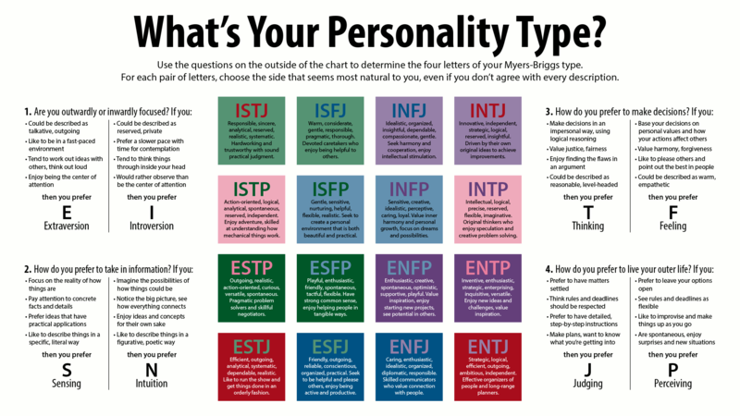

Slide 13
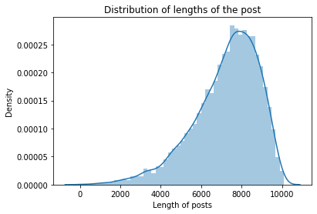
SAMPLE SCREENSHOTS:
Frequency distribution of lengths of the post
Fig 1.0. Distribution of length of the post

Slide 14
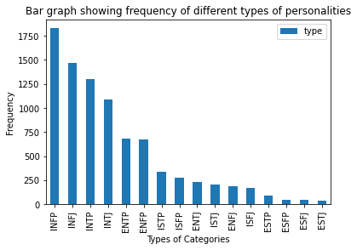
BAR GRAPH:
Bar graph showing the frequency of different types of personalities
Fig 1.1. bar graph showing different types of personalities

Slide 15
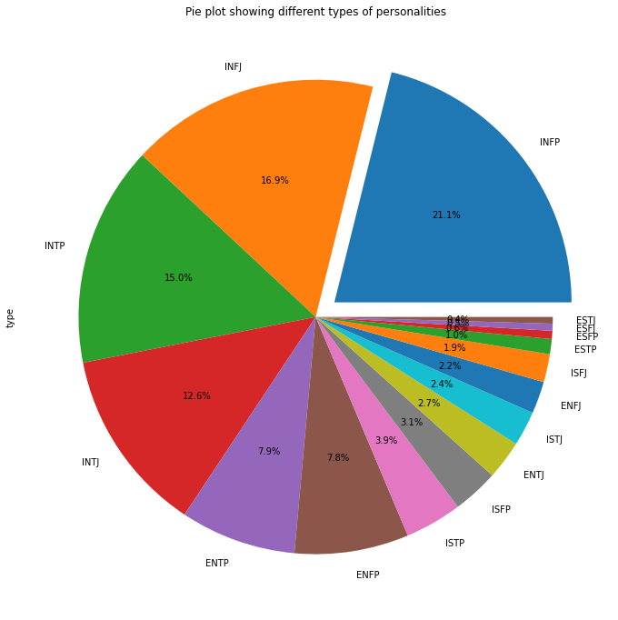
PIE CHART
Pie chart showing different personalities
Fig 1.2.Pie chart showing types of personalities

Slide 16
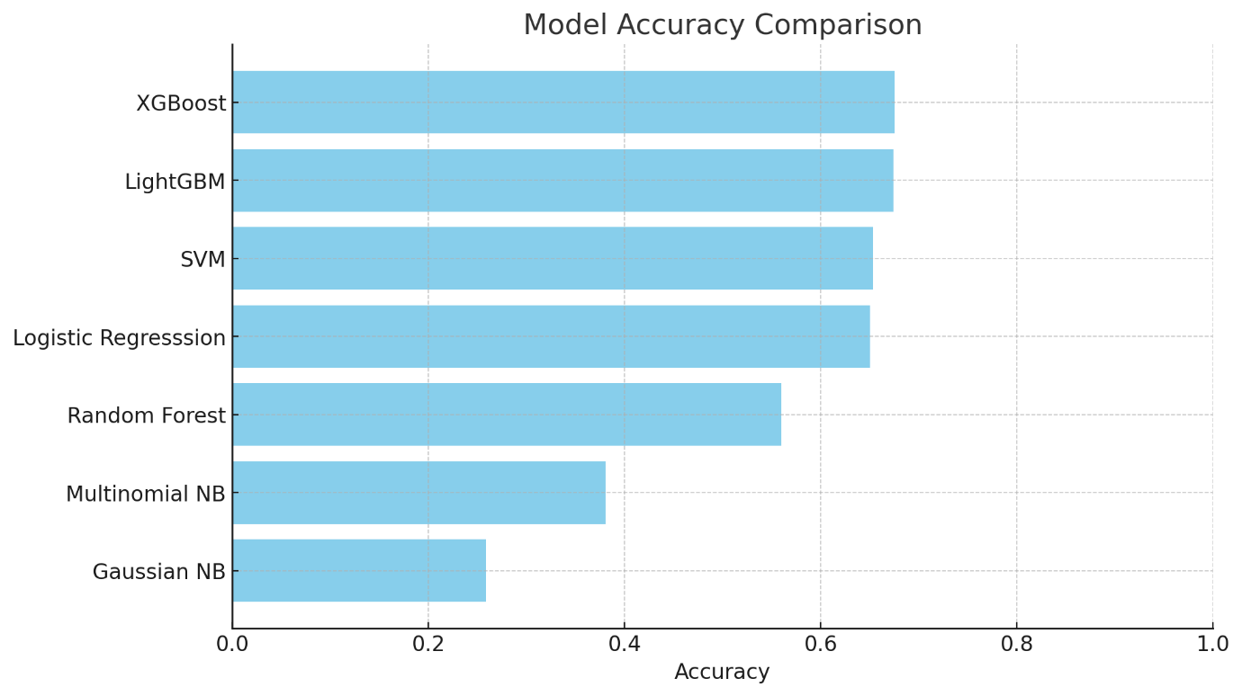
ACCURACY OF EACH MODEL:
The accuracy of each model is given as a bar graph
Fig 1.3 Bar chart of each model accuracy

Slide 17
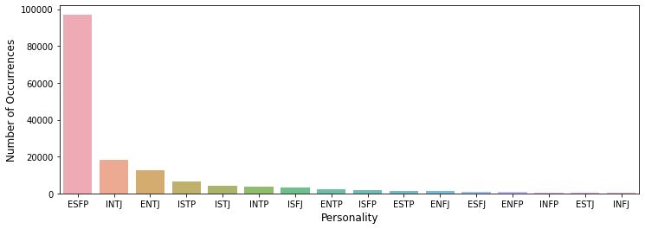
OUTPUT:
Using XGBoost algorithm the output is give below
Fig 1.4. XGBoost algorithm output for the given dataset

Slide 18
CHALLENGES
High Dimensionality of Text Data
Class Imbalance
Interpretability of Models
Data Sparsity
Computational Resources
Feature Selection
Generalization

Slide 19
ADVANTAGES
Enhanced Personalization:
Improved User Insights:
Scalability
Integration of Multiple Data Sources
Support for Mental Health Initiatives
Advancements in NLP Techniques
Cross-Cultural Applications
fgh

Slide 20
CONCLUSION
This project effectively demonstrated the use of machine learning techniques to predict personality types from textual data. By employing various algorithms, we found that models like LightGBM and XGBoost achieved the highest accuracy rates, showcasing their potential for this application. The study highlights the feasibility of utilizing user-generated content for personality prediction, which could have significant applications in areas such as marketing and mental health. Future research could focus on enhancing model performance and exploring deeper learning methodologies.

Slide 21
FUTURE WORK:
Incorporating deep learning models, such as recurrent neural networks (RNNs) or transformer-based models (e.g., BERT), could further enhance prediction accuracy by better capturing the sequential and contextual relationships within the text.
Addressing the imbalanced nature of the dataset could improve performance for underrepresented personality types, possibly through techniques like data augmentation or synthetic data generation.
Further exploration of advanced ensemble techniques and hyperparameter tuning could push the models toward higher accuracy and generalization.

Slide 22
REFERENCE
1."Smart-Hire Personality Prediction Using ML" by Isha Gupta and Manasvi Jain (May 2023)
2."A Study on Personality Prediction & Classification Using Data Mining Algorithms" by Pavitha N., Somesh Kamnapure, and Ayush Gundawa (August 2022)
3."Language Style Matters: Personality Prediction from Textual Styles Learning" by Meiling Li and Hezi Liu (November 2023)
4."Personality Prediction using Machine Learning" by Hima Vijay and Neenu Sebastian (June 2022)

Slide 23
THANK YOU

